Slide 1
What Is a DBMS?
Database: A collection of information. Eg ?
Examples: Library, University
Database Management System (DBMS) : software package designed to store and manage databases.
  Eg: Oracle, SQL server, MySQL, Access
Files vs DBMS : Why bother with databases ?
  Why not just just store all the data in a big file and write C or Java programs to manipulate the data.
Notes:
CSCI 2215 Databases
Fall 13, Week 1
CS 622/215 Databases
Fall 09, Week 1
7

Slide 2
Why Use a DBMS?
Naïve users sheltered from messy details
Data integrity:
  Eg: if Bob works in Marketing, make sure there is a dept called Marketing.
Reduced application development time: Avoid writing special programs from scratch each time to access data.
Standard Application Interface: increased reliability
Notes:
CSCI 2215 Databases
Fall 13, Week 1
CS 622/215 Databases
Fall 09, Week 1
7

Slide 3
Why Use a DBMS?
Data independence: easier to make changes
  If how data is stored changes
Security: easier to control how data is shared
Concurrent access: allow multiple users to access simultaneously
  But in a controlled way !
Notes:
CSCI 2215 Databases
Fall 13, Week 1
CS 622/215 Databases
Fall 09, Week 1
7

Slide 4
Different people involved
DBMS implementers: who build the DBMS like Oracle, MS SQL server
End users: forms, reports, SQL queries
DB application programmers: write programs to make life easier for end users.
  Eg: person who creates forms for library.
  Must know how databases work
DB administrator (DBA):
  Handles security and authorization
  Crash recovery
  Database tuning as needs evolve
Notes:
CSCI 2215 Databases
Fall 13, Week 1
CS 622/215 Databases
Fall 09, Week 1
7

Slide 5

Overview of course: Relational Model:
Student Database, Fig 1.2
STUDENT
Name StudentNumber Class Major
Smith 17 1 CS
Brown 8 2 CS
Notes:
CSCI 2215 Databases
Fall 13, Week 1
CS 622/215 Databases
Spring 10, Week
10

Slide 6
Overview of course:
Data Models:
  High level : E.R. model
  Intermediate level : relational model
    Student database
  Low level: physical database: 622B/524
Relational databases:
  Integrity constraints
  Good design : normalization
Query languages: Relational algebra, SQL
Views, Assertions, Triggers
Notes:
CSCI 2215 Databases
Fall 13, Week 1
CS 622/215 Databases
Fall 09, Week 1
7

Slide 7
Relational Data Model
Relation: 2-dimensional table
  All info stored in tables
Eg: student, course Elmasri Fig 1.2
  Rows (or tuples): student : 2 rows
    Records: a row may correspond with a record in a file
      Commonly used if we are talking about the physical storage of databases
  Columns (or attributes): student : 4 columns
Notes:
CSCI 2215 Databases
Fall 13, Week 1
CS 622/215 Databases
Fall 09, Week 1
7

Slide 8
Relational Data Model
Relational model proposed by E. F. Codd 1970
Dominant model in commercial DBMS products.
  Eg: Oracle, SQL server, MySQL, Access.
Compared to previous models (network, hierarchical etc):
  Easier to understand info in tables
  Casual user can write simple SQL queries
  Complex queries much easier to understand compared to previous models.
Notes:
CSCI 2215 Databases
Fall 13, Week 1
CS 622/215 Databases
Fall 09, Week 1
7

Slide 9
Basic Terminology
Relational Schema (or head): set of all the column names i.e. what info is being stored. For student table:
  Name, StudentNumber, Class, Major
Relational Database Schema : collection of all the relational schemas
Relational Instance (or current relational state): what data is currently in the table.
  In the Eg in Elmasri Fig 1.2 student database, there are two rows (Smith …, Brown …) in the relational instance.
Schema vs instance:
  schema changes infrequently
  instance changes often as data changes, rows added deleted.
Notes:
CSCI 2215 Databases
Fall 13, Week 1
CS 622/215 Databases
Fall 09, Week 1
7

Slide 10
Relational Rules
Attempt to standardize across different products, so can discuss design issues in general
Have to be true for relation at all times, not just happen to be true for the current relational instance
Some rules violated in some products. Why ? For efficiency and for ease of use, a “clean mathematical design” may be sacrificed.
Some rules violated in SQL itself.
Notes:
CSCI 2215 Databases
Fall 13, Week 1
CS 622/215 Databases
Fall 09, Week 1
7

Slide 11
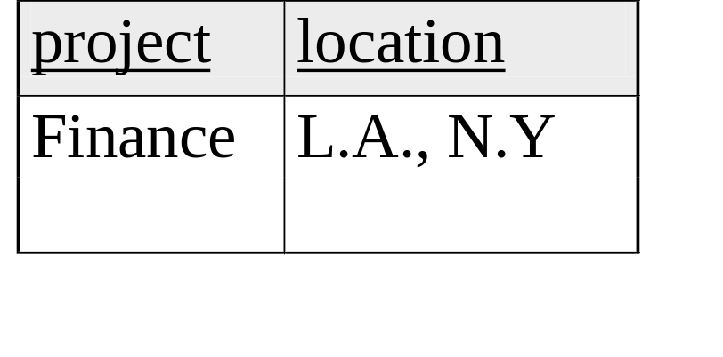
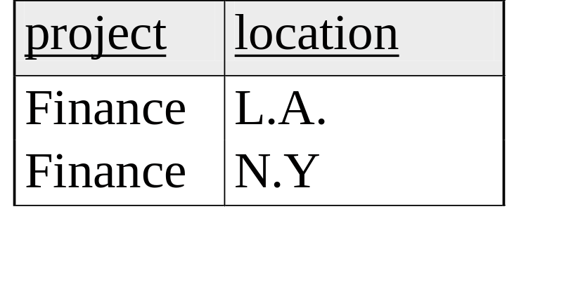
First Normal Form rule
Every value atomic: No multi-values, composite. Followed by “all” DBMS.
  Not followed in OODBMS, ORDBMS
No multi-valued field. Eg: if we are looking at locations of projects, can’t store Los Angeles, NY in single attribute
How to fix ?
Split into different rows
Notes:
CSCI 2215 Databases
Fall 13, Week 1
CS 622/215 Databases
Fall 09, Week 1
7

Slide 12
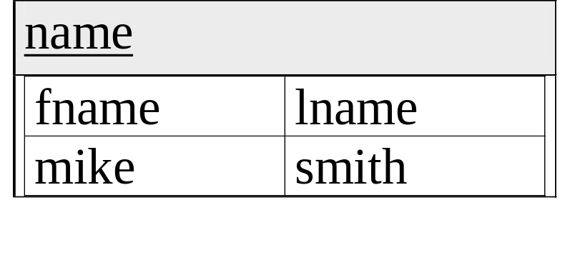
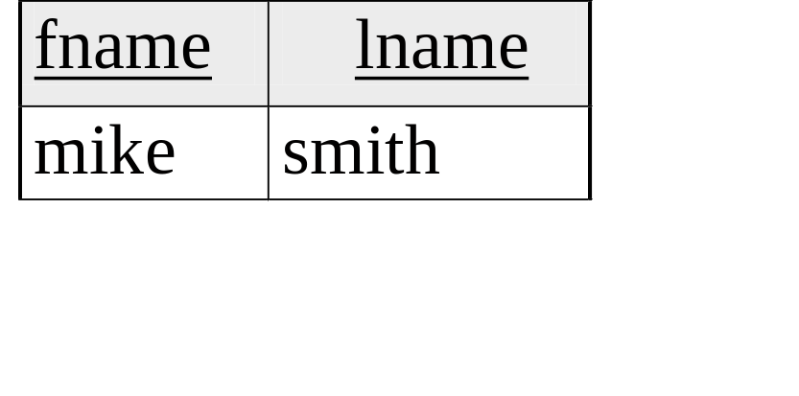
First Normal Form rule
No composite values. Eg: if we are looking to store names, can’t have sub-fields of name as fname, lname
How to solve? Split into different columns
Notes:
CSCI 2215 Databases
Fall 13, Week 1
CS 622/215 Databases
Fall 09, Week 1
10

Slide 13

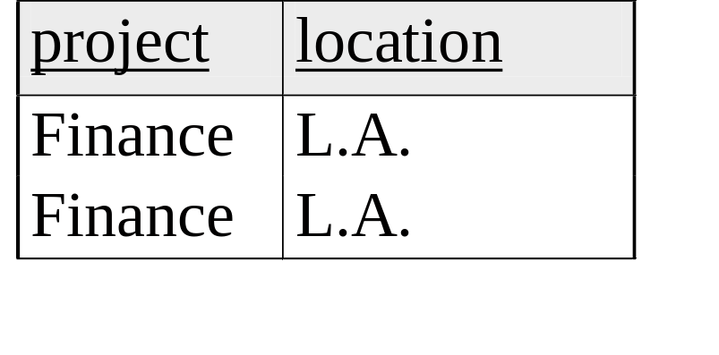
Unique Row Rule
No two rows identical: they have to differ in at least one value (one column).
OK
NOT OK
SQL allows duplicate rows: default. Why ?
Lot of work may be needed to ensure no duplicates: Eg. When combining two tables.
Duplicates may be useful. Eg. When counting how many employees make > 50k. Enumerate salaries and count
Notes:
CSCI 2215 Databases
Fall 13, Week 1
CS 622/215 Databases
Fall 09, Week 1
10

Slide 14
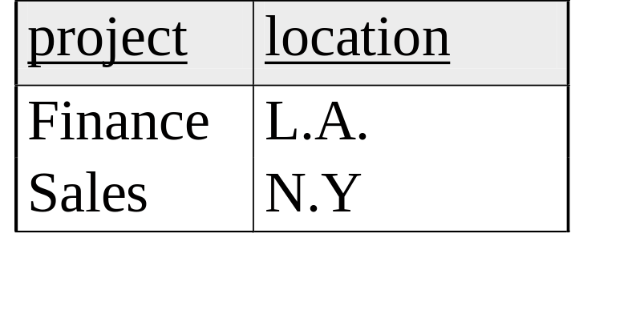
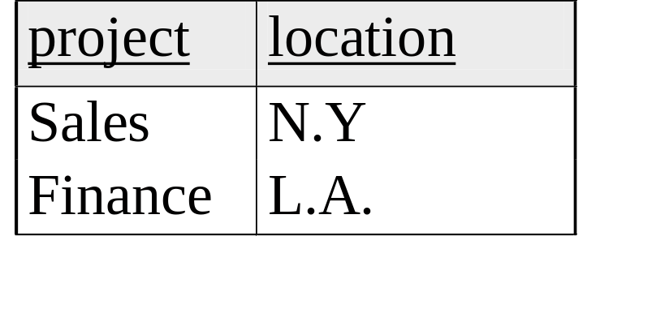
Rows not ordered
same as
To access rows: do by content (where is Sales located) rather than row # (what is the location in the 2nd row). We will assume this is true.
Commercial DBMS break this rule. Why ?
Rows ordered: logically no, physically yes
For performance, because of physical locality, order can matter.
Notes:
CSCI 2215 Databases
Fall 13, Week 1
CS 622/215 Databases
Fall 09, Week 1
10

Slide 15

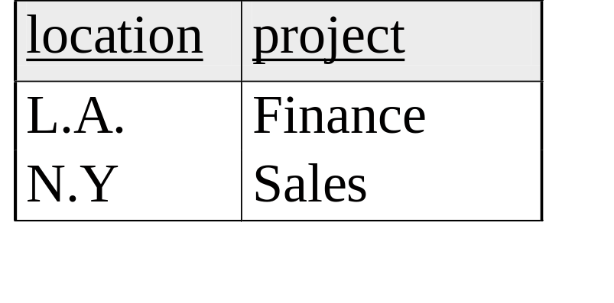
Columns not ordered
same as
Property of relations, but rule violated in SQL: Eg: when inserting a new row into the table above left, can just insert Marketing, Chicago.
  Don’t have to specify project = Marketing, location = Chicago. How ?
Since Marketing written before Chicago, DBMS will assume Marketing goes into 1st column, Chicago goes into 2nd column.
Notes:
CSCI 2215 Databases
Fall 13, Week 1
CS 622/215 Databases
Fall 09, Week 1
10

Slide 16
Domain
The values an attribute can take: Eg: string, integer, real
Domain of each attribute is specified when creating a table in SQL
Enforced by the DBMS when making changes or adding a new row.
Eg: age: integer
  If try to set age to 7.3, DBMS will not allow
Notes:
CSCI 2215 Databases
Fall 13, Week 1
CS 622/215 Databases
Fall 09, Week 1
7

Slide 17
Null value
An attribute can take null value. How to interpret ?
Doesn’t exist: Eg ?
Supervisor attribute for employees, but some employees may not have a supervisor.
Don’t know the value: Eg ?
Birth date
Don’t know if it exists or unknown value: Eg ?
Work phone for customers in online store database: customer may not have, or may choose not to give
Notes:
CSCI 2215 Databases
Fall 13, Week 1
CS 622/215 Databases
Fall 09, Week 1
7

Slide 18
Keys
Super key of a relation: one or more attributes that uniquely identifies which rows we are talking about.
Eg: for COURSE table which are super keys?
{C#}, {CName}, {C#, CName}, {C#,Dept}…
Has to be time invariant: always true, not just happens to be true for current instance
Eg: in STUDENT, Name is unique, but may not always be true
Notes:
CSCI 2215 Databases
Fall 13, Week 1
CS 622/215 Databases
Fall 09, Week 1
7

Slide 19
Keys
Have to look at semantics: to decide if superkey, is not enough to look at instance
Key: a super key which is minimal i.e. if we remove any attribute from a key, will no longer uniquely identify a row.
Eg: {C#, CName} for COURSE is a super key, but not a key because C# is a key.
Composite keys: more than one attribute. Eg?
Eg: GRADEREPORT, only key is {St#,SecId}
Notes:
CSCI 2215 Databases
Fall 13, Week 1
CS 622/215 Databases
Fall 09, Week 1
7

Slide 20
Keys
Can have multiple keys: Eg: C#, Cname keys
Primary Key: One key is picked as primary key. Shown by underlining.
Which is picked can have an impact
  Foreign keys can refer only to primary keys
  File may be sorted by primary key (or index), so searches may be more efficient (622B/524).
Pick natural and simple one. Eg: C#
Can also be done through auto-number
All primary keys for course database ?
Notes:
CSCI 2215 Databases
Fall 13, Week 1
CS 622/215 Databases
Fall 09, Week 1
7

Slide 21
Foreign Keys
Suppose added a new row in GRADEREPORT : (14,117,B). Is this OK ?
No: because no 117 in section:
  any section is in GRADEREPORT also has to be in SECTION table.
Section_id in GRADEREPORT is foreign key to Section_id in SECTION :
  a value for Section_id in GRADEREPORT has to also occur in SECTION
How to show: using arrows.
Foreign key, primary keys are glue for diff. tables
All foreign keys for course database
Notes:
CSCI 2215 Databases
Fall 13, Week 1
CS 622/215 Databases
Fall 09, Week 1
7

Slide 22
Foreign Keys
F. Key may be composite:
  Eg: if in student table: (fname, lname) P. Key
  In Gradereport (fname, lname) stored instead of student_number
  (fname, lname) composite F. Key. Is this different to saying fname F. Key and lname F. Key ?
F. Key has to be Time invariant: always true
  Not enough that it is true for one instance
  Eg: student_number from Student to Gradereport
    Is this a valid F. Key ?
No : in other instances may not be the case
Notes:
CSCI 2215 Databases
Fall 13, Week 1
CS 622/215 Databases
Fall 09, Week 1
7

Slide 23
Foreign Keys
F. Key can be null:
  Eg: suppose had an instructor table also
  Section 145 has no instructor
  So either F. Key should be null or exist in referenced table
F. Key could itself be part of P. key: Eg ?
In Prerequisite table, Prerequisite_number
Self referential: F. Key can refer to a P. Key in the same relation.
  Eg: if prerequisite info being kept in Course table
Notes:
CSCI 2215 Databases
Fall 13, Week 1
CS 622/215 Databases
Fall 09, Week 1
7

Slide 24
Elmasri Company Database
The company is organized into DEPARTMENTS.
Each department has a name, number and an employee who manages the department
  We keep track of the start date of the department manager
  Departments can have multiple locations
Each department controls a number of PROJECTs.
Each project has a name, number and is located at a single location.
Notes:
CSCI 2215 Databases
Fall 13, Week 1
CS 622/215 Databases
Fall 09, Week 1
7

Slide 25
Elmasri Company Database
For each EMPLOYEE, we store the social security number, address, salary, sex, and birthdate.
Employees may have a supervisor
  DIFFERENT FROM (and no connection to) manager
Each employee works for one department but may work on several projects.
We keep track of the number of hours per week that an employee currently works on each project.
Each employee may have a number of DEPENDENTs.
  For each dependent, we keep track of their name, sex, birthdate, and relationship to employee.
Notes:
CSCI 2215 Databases
Fall 13, Week 1
CS 622/215 Databases
Fall 09, Week 1
7

Slide 26
Elmasri Company Database
What will be the different tables ?
What will be the primary keys ?
What will be the foreign keys ?
An example instance
Notes:
CSCI 2215 Databases
Fall 13, Week 1
CS 622/215 Databases
Fall 09, Week 1
7

Slide 27
Elmasri COMPANY database schema

Slide 28
Elmasri database with FK: Figure 3.7

Slide 29

Elmasri Figure 3.6: Relational Instance

Slide 30
In class problem: relational schemas
Database keeps track of student enrollment in courses and the books adopted for each course:
STUDENT(SSN, Name, Major, Bdate)
COURSE(Course#, Cname, Dept)
ENROLL(SSN, Course#, Quarter, Grade)
BOOK_ADOPTION(Course#, Quarter, Book_ISBN)
TEXT(Book_ISBN, Book_Title, Publisher, Author)
Why is Quarter part of P.Key in Enroll ?
Suppose Book_ISBN was part of P.K. in the BOOK_ADOPTION table
  How would we interpret that ?
Draw relational schema specifying foreign keys.

Slide 31
Premiere Products Database: from Pratt and Adamski
Sales Reps
  Sales rep number, last name, first name, address, total commission, commission rate
Customers
  Customer number, name, address, current balance, credit limit, customer sales rep
Parts Inventory
  Part number, description, number units on hand, item class, warehouse number, unit price

Slide 32
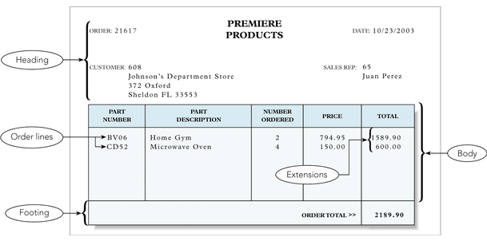
Figure 1.2: Premiere Products Sample Order

Slide 33
Premiere Products Customer Order
Order
  Order number, order date, customer number
Order line
  Order number, part number, number units ordered, unit price
Overall order total
  Not stored since it can be calculated

Slide 34
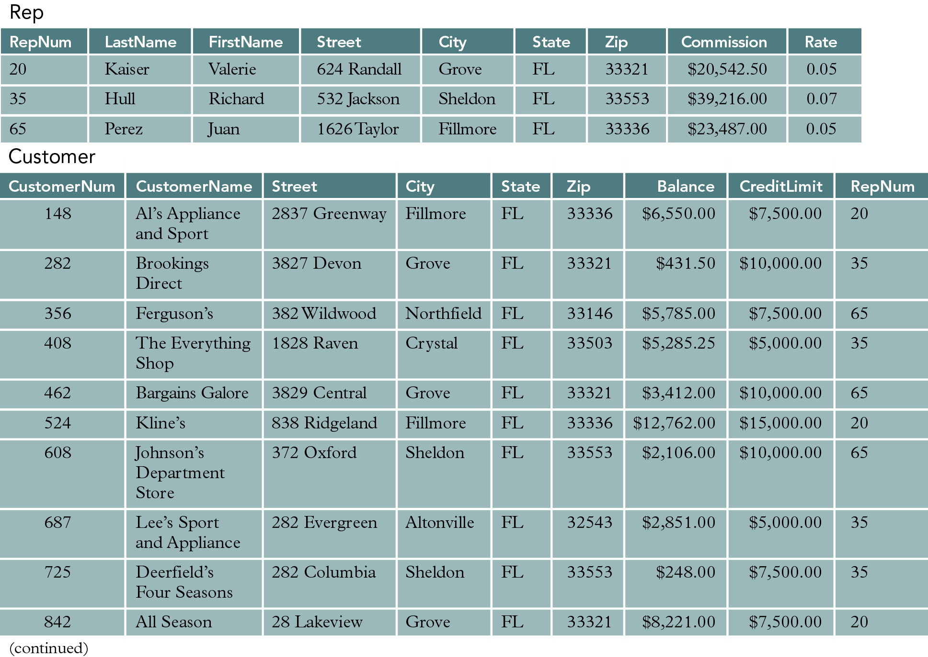
Premiere Products Sample Data

Slide 35
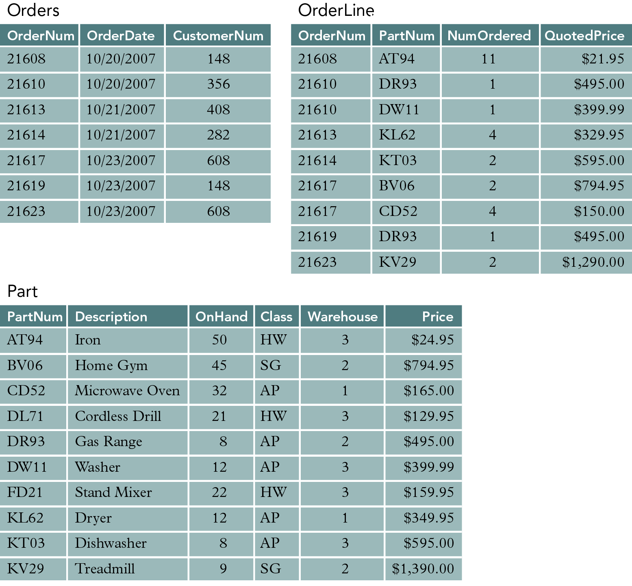
Premiere Products Sample Data

